Slide 1
Classification
Definition
Classification Techniques
Decision Tree Induction

Slide 2
Classification: Definition
Given a collection of records (training set )
Each record contains a set of attributes, one of the attributes is the class.
Find a model for class attribute as a function of the values of other attributes.
Goal: previously unseen records should be assigned a class as accurately as possible.
A test set is used to determine the accuracy of the model. Usually, the given data set is divided into training and test sets, with training set used to build the model and test set used to validate it.

Slide 3
Classification: Model Construction
Classification
Algorithms
Training
Data
Classifier
(Model)
IF rank = ‘professor’
OR years > 6
THEN tenured = ‘yes’

Slide 4
Classification: Use the Model
Classifier
Testing
Data
Unseen Data
(Jeff, Professor, 4)
Tenured?

Slide 5

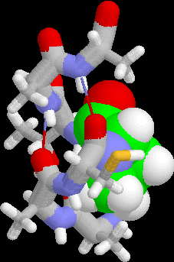
Examples of Classification Task
Predicting tumor cells as benign or malignant
Classifying credit card transactions as legitimate or fraudulent
Classifying secondary structures of protein as alpha-helix, beta-sheet, or random coil
Categorizing news stories as finance, weather, entertainment, sports, etc

Slide 6
Process
f(X)
Training data: X
Class labels Y
A classifier, a mapping, a hypothesis
f(U)
Test data: U
Predicted class labels

Slide 7
Relational Representation of Gene Expression Data
n features (order of 1000)
gene₁ gene₂ gene₃ gene₄ … gene_{n}
class
x₁₁ x₁₂ x₁₃ x₁₄ … x_{1n}
x₂₁ x₂₂ x₂₃ x₂₄ … x_{2n}
x₃₁ x₃₂ x₃₃ x₃₄ … x_{3n}
………………………………….
x_{m1} x_{m2} x_{m3} x_{m4} … x_{mn}
P
N
P
N
m samples

Slide 8
Classification: 2 Step Process
Model construction: describing a set of predetermined classes
Each tuple/sample is assumed to belong to a predefined class, as determined by the class label attribute
The set of tuples used for model construction: training set
The model is represented as classification rules, decision trees, or mathematical formulae
Model usage: for classifying future or unknown objects
Estimate accuracy of the model
The known label of test sample is compared with the classified result from the model
Accuracy rate is the percentage of test set samples that are correctly classified by the model
Test set is independent of training set, otherwise over-fitting will occur

Slide 9
Classifier Accuracy
Partition: Training-and-testing
use two independent data sets, e.g., training set (2/3), test set(1/3)
used for data set with large number of samples
Cross-validation
divide the data set into k subsamples
use k-1 subsamples as training data and one sub-sample as test data --- k-fold cross-validation
for data set with moderate size
Leave-one-out cross validation
for small size data

Slide 10
Classification Techniques
Decision Tree based Methods
Rule-based Methods
Neural Networks
Naïve Bayes and Bayesian Belief Networks
Support Vector Machines

Slide 11
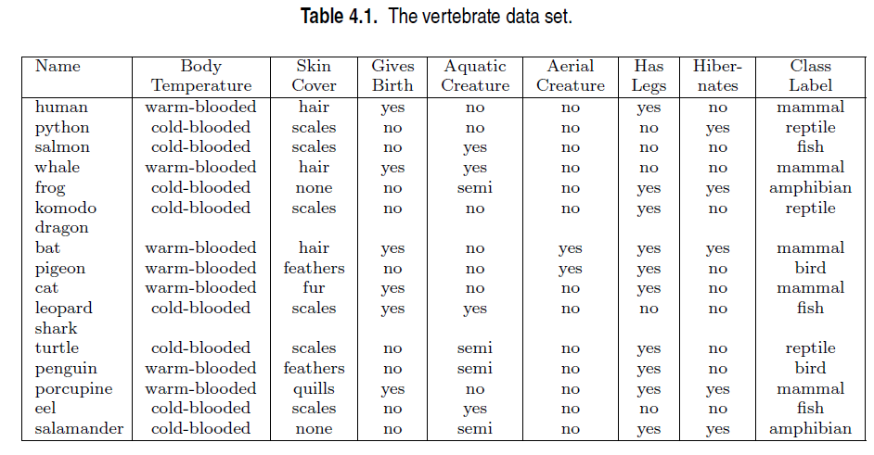
Example

Slide 12
Example of a Decision Tree
categorical
categorical
continuous
class
Splitting Attributes
Refund
Yes
No
NO
MarSt
Single, Divorced
Married
TaxInc
NO
< 80K
> 80K
NO
YES
Training Data
Model: Decision Tree

Slide 13
Another Example of Decision Tree
categorical
categorical
continuous
class
MarSt
Single, Divorced
Married
NO
Refund
Yes
No
NO
TaxInc
< 80K
> 80K
NO
YES
There could be more than one tree that fits the same data!

Slide 14
Decision Tree Classification Task
Decision Tree

Slide 15
Apply Model to Test Data
Start from the root of tree.
Test Data
Refund
Yes
No
NO
MarSt
Single, Divorced
Married
TaxInc
NO
< 80K
> 80K
NO
YES

Slide 16
Apply Model to Test Data
Test Data
Refund
Yes
No
NO
MarSt
Single, Divorced
Married
TaxInc
NO
< 80K
> 80K
NO
YES

Slide 17
Apply Model to Test Data
Test Data
Refund
Yes
No
NO
MarSt
Single, Divorced
Married
TaxInc
NO
< 80K
> 80K
NO
YES

Slide 18
Apply Model to Test Data
Test Data
Refund
Yes
No
NO
MarSt
Single, Divorced
Married
TaxInc
NO
< 80K
> 80K
NO
YES

Slide 19
Apply Model to Test Data
Test Data
Refund
Yes
No
NO
MarSt
Single, Divorced
Married
TaxInc
NO
< 80K
> 80K
NO
YES

Slide 20
Apply Model to Test Data
Test Data
Refund
Yes
No
NO
MarSt
Single, Divorced
Married
Assign Cheat to “No”
TaxInc
NO
< 80K
> 80K
NO
YES

Slide 21
Decision Tree Classification Task
Decision Tree

Slide 22
Decision Tree Induction
Many Algorithms:
Hunt’s Algorithm (one of the earliest)
CART
ID3, C4.5
SLIQ,SPRINT

Slide 23
General Structure of Hunt’s Algorithm
Let D_{t} be the set of training records that reach a node t
General Procedure:
If D_{t} contains records that belong the same class y_{t}, then t is a leaf node labeled as y_{t}
If D_{t} is an empty set, then t is a leaf node labeled by the default class, y_{d}
If D_{t} contains records that belong to more than one class, use an attribute test to split the data into smaller subsets. Recursively apply the procedure to each subset.
D_{t}
?

Slide 24
Hunt’s Algorithm
Refund
Don’t
Cheat
Yes
No
Don’t
Cheat
Don’t
Cheat
Refund
Refund
Yes
No
Yes
No
Don’t
Cheat
Marital
Status
Don’t
Cheat
Marital
Status
Single,
Divorced
Single,
Divorced
Married
Married
Cheat
Don’t
Cheat
Taxable
Income
Don’t
Cheat
< 80K
>= 80K
Don’t
Cheat
Cheat

Slide 25
Algorithm for Decision Tree Induction
Basic algorithm (a greedy algorithm)
Tree is constructed in a top-down recursive divide-and-conquer manner
At start, all the training examples are at the root
Attributes are categorical (if continuous-valued, they are discretized in advance)
Examples are partitioned recursively based on selected attributes
Test attributes are selected on the basis of a heuristic or statistical measure (e.g., information gain)
Conditions for stopping partitioning
All samples for a given node belong to the same class
There are no remaining attributes for further partitioning – majority voting is employed for classifying the leaf
There are no samples left

Slide 26
Decision Tree Induction: Training Dataset

Slide 27
Output: A Decision Tree for “buys_computer”
age?
<=30
overcast
>40
31..40
student?
yes
credit rating?
no
yes
excellent
fair
no
yes
no
yes

Slide 28
Decision Tree Classification
A decision tree is created in two phases:
Tree Building Phase
Repeatedly partition the training data until all the examples in each partition belong to one class or the partition is sufficiently small
Tree Pruning Phase
Remove dependency on statistical noise or variation that may be particular only to the training set

Slide 29
Tree Building Phase
General tree-growth algorithm (binary tree)
Partition(Data S)
If (all points in S are of the same class) then return;
for each attribute A do
evaluate splits on attribute A;
Use best split to partition S into S1 and S2;
Partition(S1);
Partition(S2);

Slide 30
Tree Building Phase (cont.)
The form of the split depends on the type of the attribute
Splits for numeric attributes are of the form A ≤ v, where v is a real number
Splits for categorical attributes are of the form A ∈ S’, where S’ is a subset of all possible values of A

Slide 31
Tree Induction
Greedy strategy.
Split the records based on an attribute test that optimizes certain criterion.
Issues
Determine how to split the records
How to specify the attribute test condition?
How to determine the best split?
Determine when to stop splitting

Slide 32
Tree Induction
Greedy strategy.
Split the records based on an attribute test that optimizes certain criterion.
Issues
Determine how to split the records
How to specify the attribute test condition?
How to determine the best split?
Determine when to stop splitting

Slide 33
How to Specify Test Condition?
Depends on attribute types
Nominal
Ordinal
Continuous
Depends on number of ways to split
2-way split
Multi-way split

Slide 34
Splitting Based on Nominal Atts.
Multi-way split: Use as many partitions as distinct values.
Binary split: Divides values into two subsets. Need to find optimal partitioning.
CarType
Family
Luxury
Sports
CarType
CarType
OR
{Sports, Luxury}
{Family, Luxury}
{Family}
{Sports}

Slide 35
Splitting Based on Ordinal Attributes
Multi-way split: Use as many partitions as distinct values.
Binary split: Divides values into two subsets. Need to find optimal partitioning.
What about this split?
Size
Small
Large
Medium
Size
Size
{Small, Medium}
OR
{Large}
{Medium, Large}
{Small}
Size
{Small, Large}
{Medium}

Slide 36
Splitting Based on Continuous Atts.
Different ways of handling
Discretization to form an ordinal categorical attribute
discretize once at the beginning
ranges can be found by equal interval bucketing, equal frequency bucketing (percentiles), or clustering.
Binary Decision: (A < v) or (A ≥ v)
consider all possible splits and finds the best cut
can be more compute intensive

Slide 37
Splitting Based on Continuous Atts.

Slide 38
Tree Induction
Greedy strategy.
Split the records based on an attribute test that optimizes certain criterion.
Issues
Determine how to split the records
How to specify the attribute test condition?
How to determine the best split?
Determine when to stop splitting

Slide 39
How to determine the Best Split
Before Splitting: 10 records of class 0, 10 records of class 1
Which test condition is the best?

Slide 40
How to determine the Best Split
Greedy approach:
Nodes with homogeneous class distribution are preferred
Need a measure of node impurity:
Non-homogeneous,
High degree of impurity
Homogeneous,
Low degree of impurity

Slide 41
Measures of Node Impurity
Measures of Node Impurity
Gini Index
Entropy
Misclassification error

Slide 42
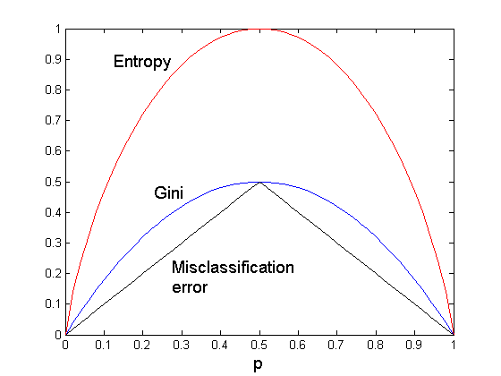
Comparison among Splitting Criteria
For a 2-class problem:

Slide 43
How to Find the Best Split
Before Splitting:
M0
A?
B?
Yes
No
Yes
No
Node N1
Node N2
Node N3
Node N4
M1
M2
M3
M4
M12
M34
Gain = M0 – M12 vs M0 – M34

Slide 44
Measure of Impurity: GINI
Gini Index for a given node t :
(NOTE: p( j | t) is the relative frequency of class j at node t).
Maximum (1 - 1/n_{c}) when records are equally distributed among all classes, implying least interesting information
Minimum (0.0) when all records belong to one class, implying most interesting information

Slide 45
Examples for computing GINI
P(C1) = 0/6 = 0 P(C2) = 6/6 = 1
Gini = 1 – P(C1)² – P(C2)² = 1 – 0 – 1 = 0
P(C1) = 1/6 P(C2) = 5/6
Gini = 1 – (1/6)² – (5/6)² = 0.278
P(C1) = 2/6 P(C2) = 4/6
Gini = 1 – (2/6)² – (4/6)² = 0.444

Slide 46
Splitting Based on GINI
Used in CART, SLIQ, SPRINT.
When a node p is split into k partitions (children), the quality of split is computed as,
where, n_{i} = number of records at child i,
n = number of records at node p.

Slide 47
Binary Attributes: Computing GINI Index
Splits into two partitions
Effect of Weighing partitions:
Larger and Purer Partitions are sought for.
B?
Yes
No
Node N1
Node N2
Gini(N1) = 1 – (5/7)² – (2/7)² =
Gini(N2) = 1 – (1/5)² – (4/5)² =
Gini(Children) = 7/12 * + 5/12 * =

Slide 48
Categorical Attributes: Computing Gini Index
For each distinct value, gather counts for each class in the dataset
Use the count matrix to make decisions
Multi-way split
Two-way split
(find best partition of values)

Slide 49
Splitting Criteria based on INFO
Entropy at a given node t:
(NOTE: p( j | t) is the relative frequency of class j at node t).
Measures homogeneity of a node.
Maximum (log n_{c}) when records are equally distributed among all classes implying least information
Minimum (0.0) when all records belong to one class, implying most information

Slide 50
Examples for computing Entropy
P(C1) = 0/6 = 0 P(C2) = 6/6 = 1
Entropy = – 0 log 0 – 1 log 1 = – 0 – 0 = 0
P(C1) = 1/6 P(C2) = 5/6
Entropy = – (1/6) log₂ (1/6) – (5/6) log₂ (1/6) = 0.65
P(C1) = 2/6 P(C2) = 4/6
Entropy = – (2/6) log₂ (2/6) – (4/6) log₂ (4/6) = 0.92

Slide 51
Splitting Criteria based on Classification Error
Classification error at a node t :
Measures misclassification error made by a node.
Maximum (1 - 1/n_{c}) when records are equally distributed among all classes, implying least interesting information
Minimum (0.0) when all records belong to one class, implying most interesting information

Slide 52
Examples for Computing Error
P(C1) = 0/6 = 0 P(C2) = 6/6 = 1
Error = 1 – max (0, 1) = 1 – 1 = 0
P(C1) = 1/6 P(C2) = 5/6
Error = 1 – max (1/6, 5/6) = 1 – 5/6 = 1/6
P(C1) = 2/6 P(C2) = 4/6
Error = 1 – max (2/6, 4/6) = 1 – 4/6 = 1/3

Slide 53
Splitting Based on INFO...
Information Gain:
Parent Node, p is split into k partitions;
n_{i} is number of records in partition i
Measures Reduction in Entropy achieved because of the split. Choose the split that achieves most reduction (maximizes GAIN)
Used in ID3 and C4.5
Disadvantage: Tends to prefer splits that result in large number of partitions, each being small but pure.

Slide 54
Splitting Based on INFO...
Gain Ratio:
Parent Node, p is split into k partitions
n_{i} is the number of records in partition i
Adjusts Information Gain by the entropy of the partitioning (SplitINFO). Higher entropy partitioning (large number of small partitions) is penalized!
Used in C4.5
Designed to overcome the disadvantage of Information Gain

Slide 55
Continuous Attributes: Computing Gini Index
Use Binary Decisions based on one value
Several Choices for the splitting value
Number of possible splitting values = Number of distinct values
Each splitting value has a count matrix associated with it
Class counts in each of the partitions, A < v and A ≥ v
Simple method to choose best v
For each v, scan the database to gather count matrix and compute its Gini index
Computationally Inefficient! Repetition of work.

Slide 56
Continuous Attributes: Computing Gini Index..
For efficient computation: for each attribute,
Sort the attribute on values
Linearly scan these values, each time updating the count matrix and computing gini index
Choose the split position that has the least gini index
Sorted Values
Split Positions

